Slide 1

Fault Detection for the Control of Supermarket Refrigeration Systems
Zoltan Mark Pinter
Supervisors: Hans Henrik Niemann, Dimitrios Papageorgiou
External Supervisor: Lars Finn Sloth Larsen
3th September, 2019

Slide 2
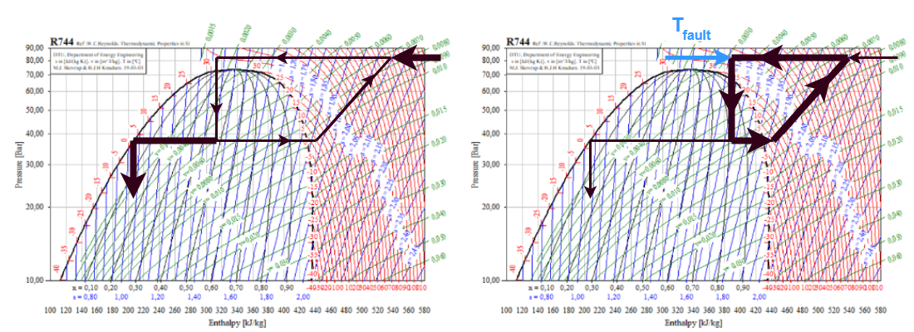
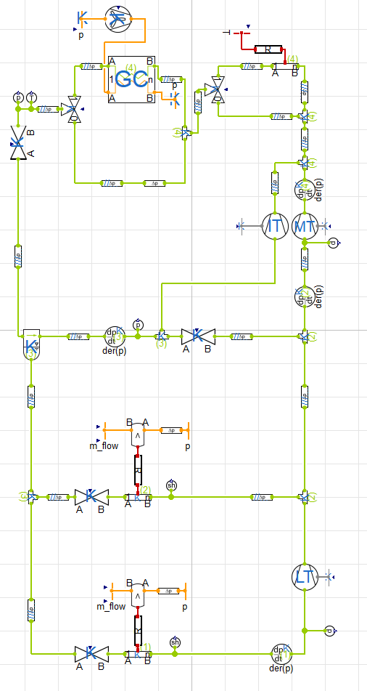
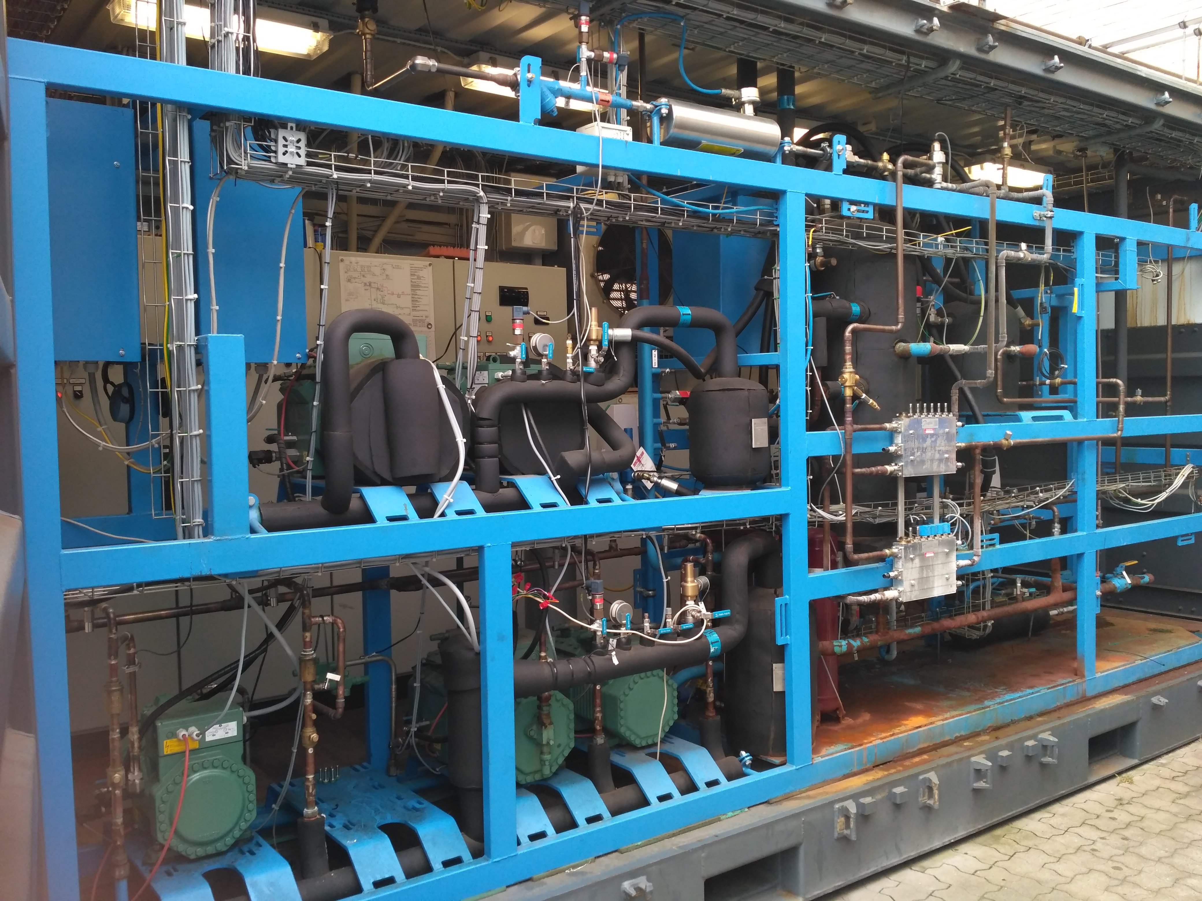
Introduction
The gas loop
Measurement error
Effects: reducing efficiency and heating cabinets
Project goal
Early detection and fault accommodation
Gas loop shall not be entered
Project scope
Field experiment and simulation
Residual generation
Fault detection
Measurement reconstruction
Simulation
Fault accommodation
Operation domain: 10...30 °C

Slide 3
Schedule
Gas Loop Problem
Physical and Mathematical Model
Simplifications
Short introduction to the investigated plants
State estimator
Residual analysis
Recursive Least Squares (RLS) algorithm
Fault Detectors
Results and Evaluation
Conclusion and Discussion

Slide 4
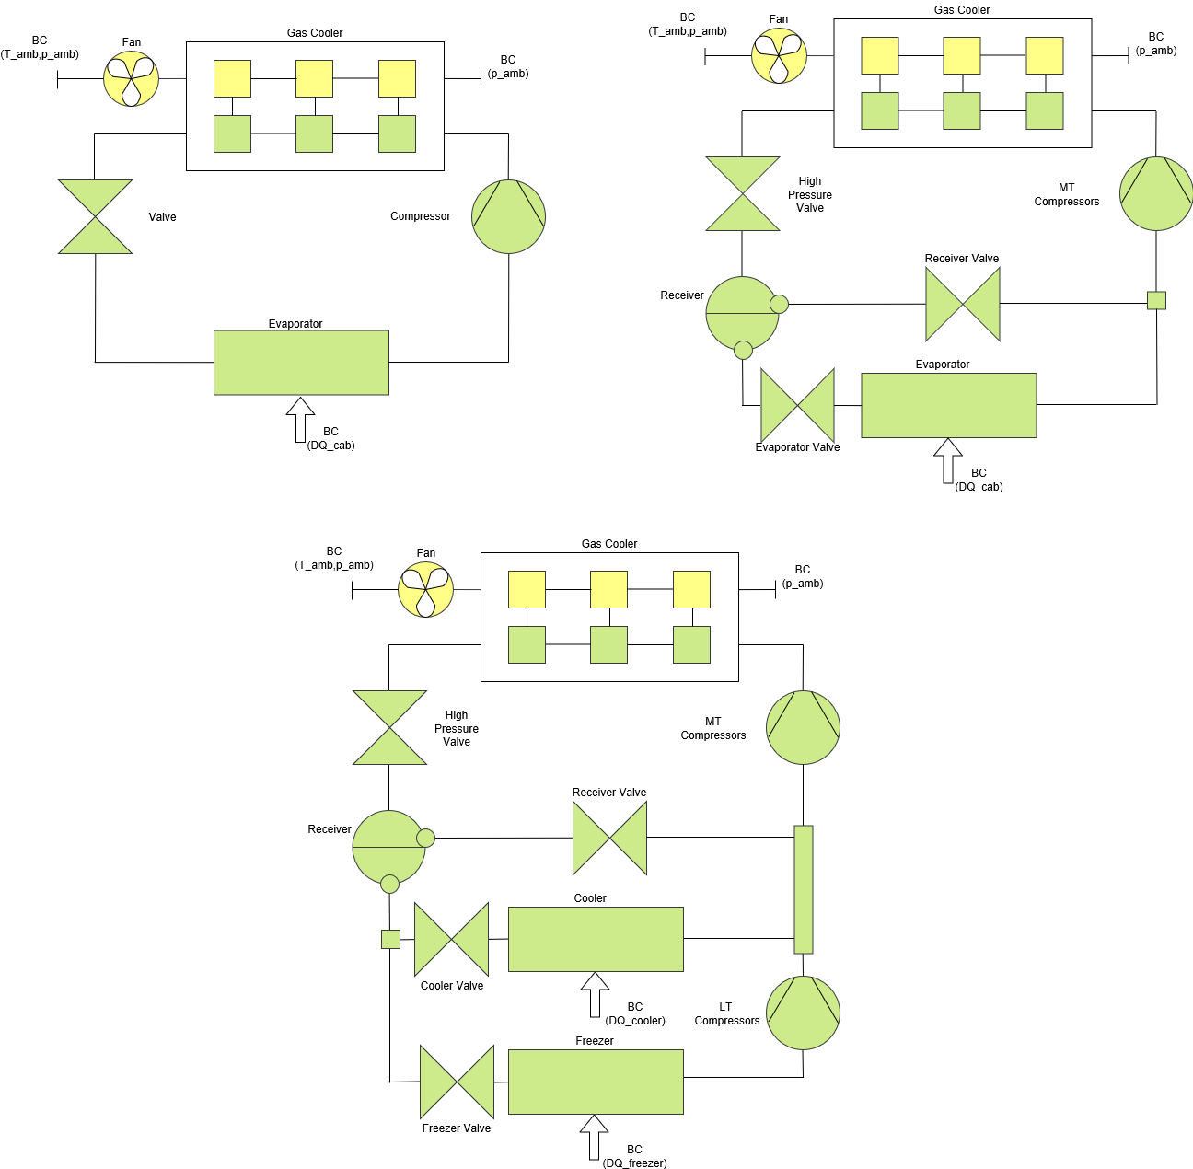
The gas loop

Slide 5
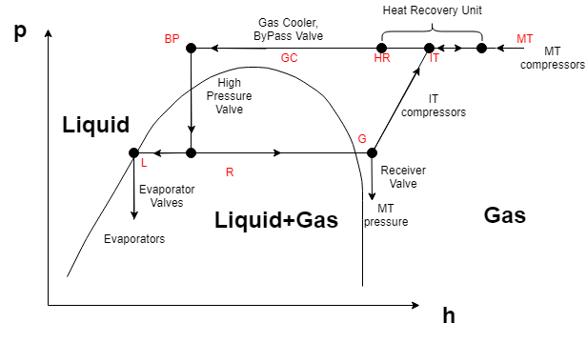
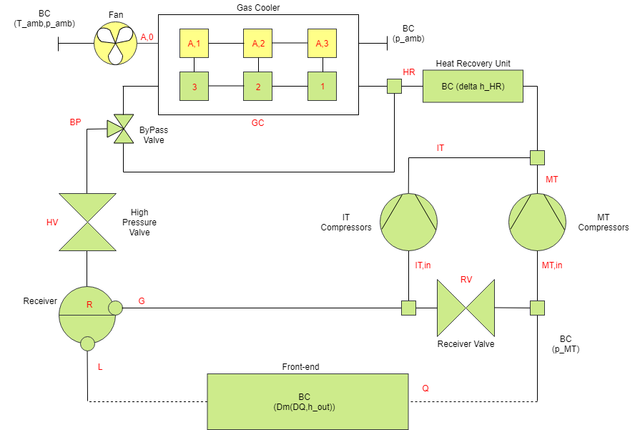
Physical model
Back-end and front-end
Different dynamics

Slide 6
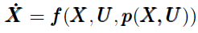
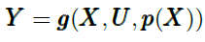
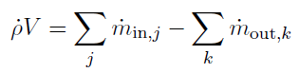
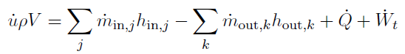
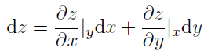
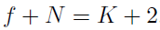
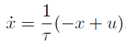
Mathematical model – differential equations
Goal: state space model description
Applied differential equations
Mass balance equation
Energy balance equation
Chain rule
Two properties: given by the phase rule
Low pass filter

Slide 7
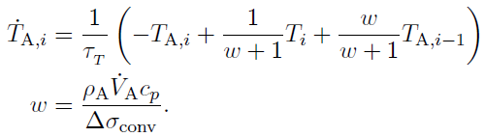
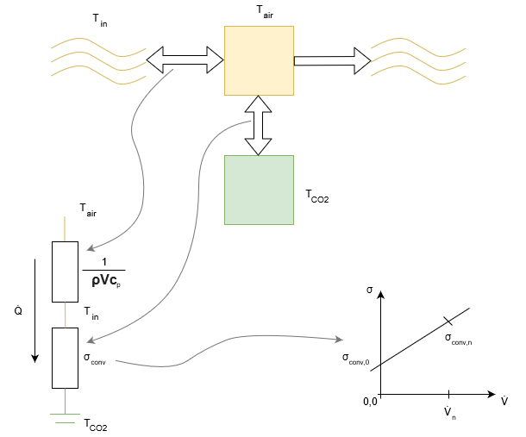
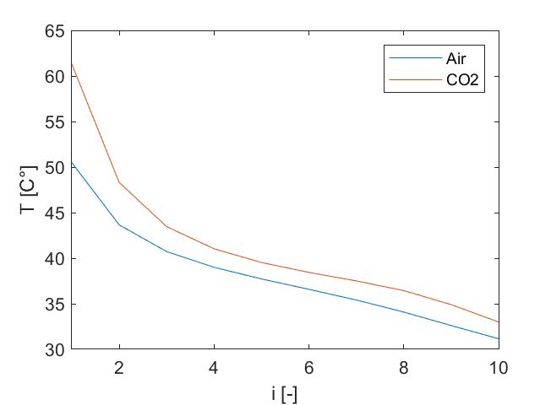
Mathematical model – heat transfer
Discretization of gas cooler: equal volume cells
Energy balance
Most assumptions are made here
Linear resistance model
First order convection model
Unknown time constant
Neglected spatial temperature difference distribution

Slide 8
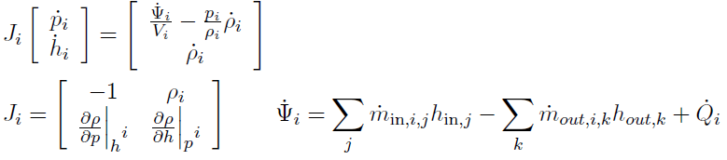
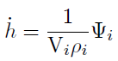
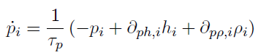
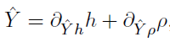
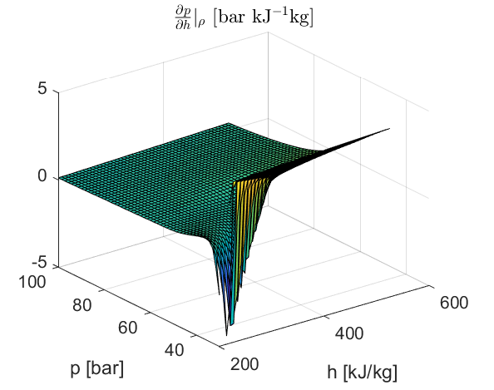
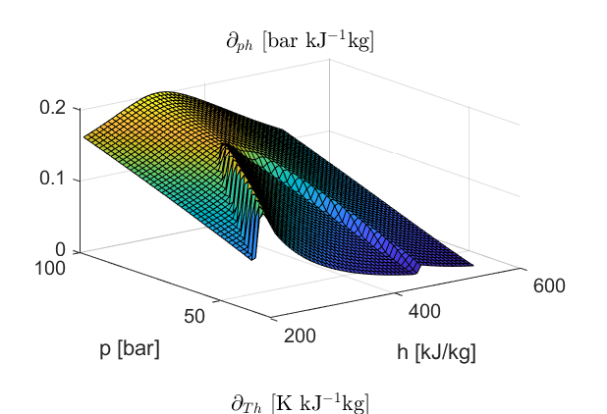
Mathematical model - simplifications
Main problems
Controllability issues
Information distribution of estimator
Large range of partial differentials
Solutions
No bypass valve and heat recovery unit
One-cell gas cooler
Perception of dynamics
Look-up table, assuming steady state

Slide 9
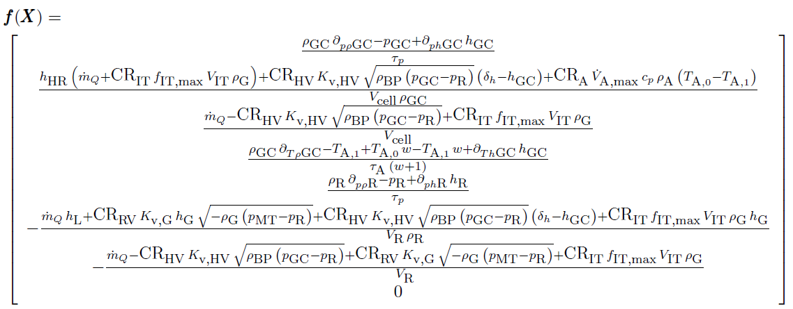
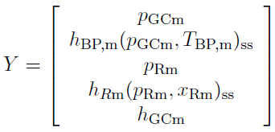
Mathematical model
Nonlinear model
Disturbance: enthalpy difference
Linearization
Analysis at a set-point
Conversion to discrete time (1s)

Slide 10
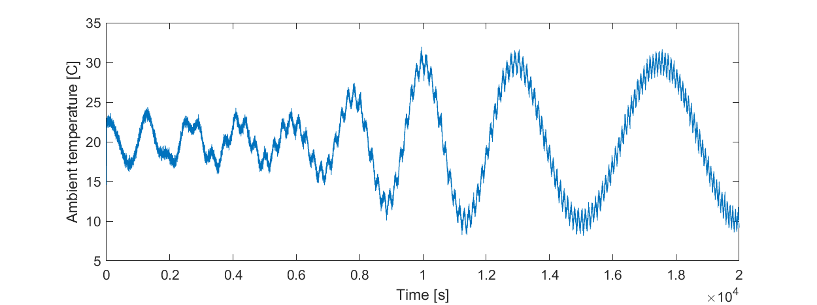
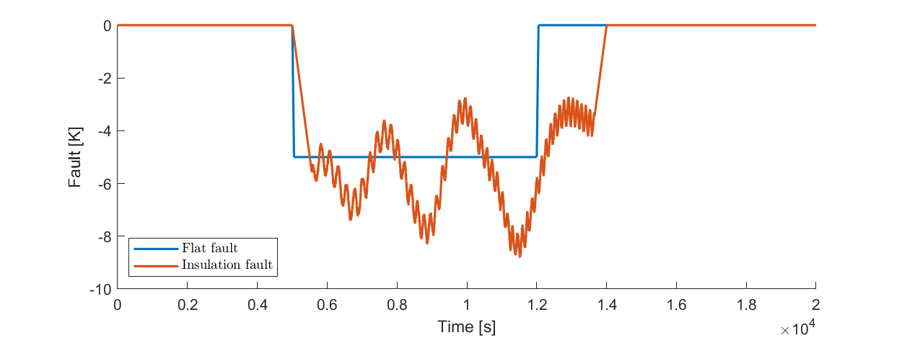
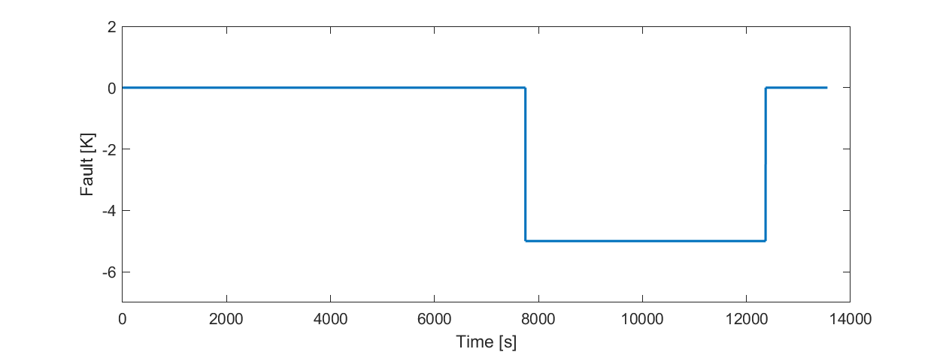
The plants
Field experiment
Simulation

Slide 11
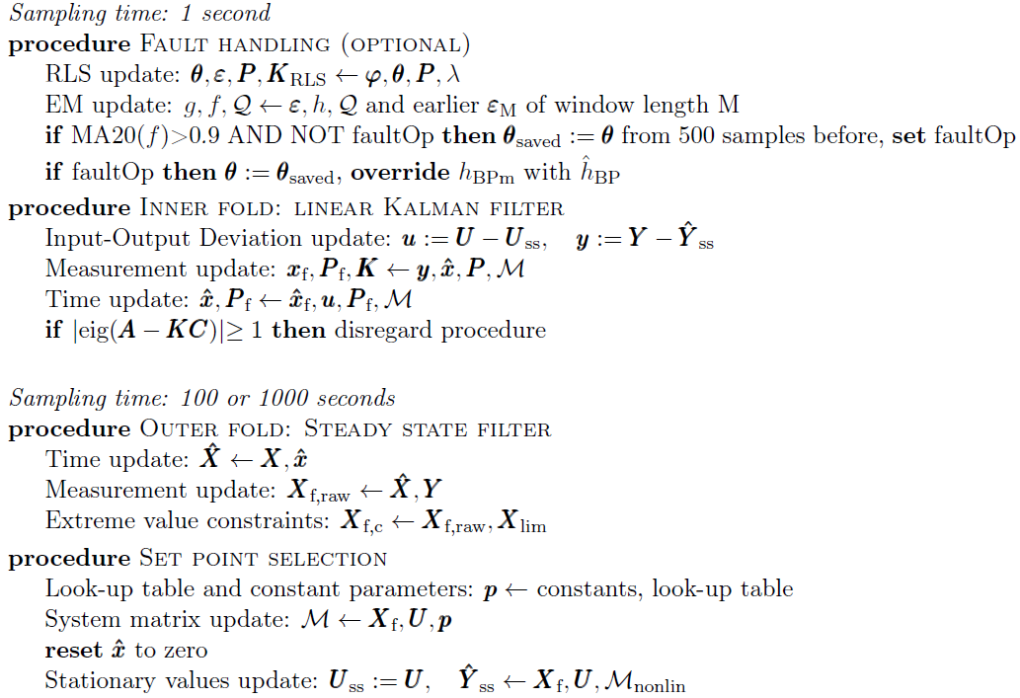
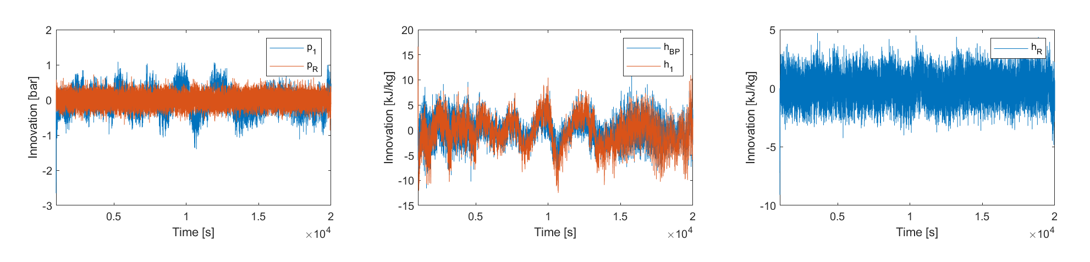
The state estimator

Slide 12
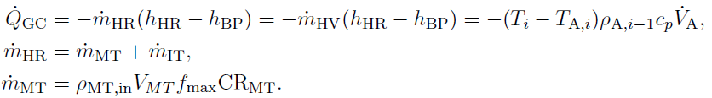
Parameter estimation and residuals
The main challenges are
Set-point change has the same effect as the fault
Dynamical signals
Non-Gaussian noise
Physical background
Energy accumulation should be bounded in the gas cooler

Slide 13
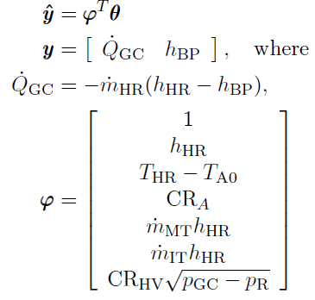
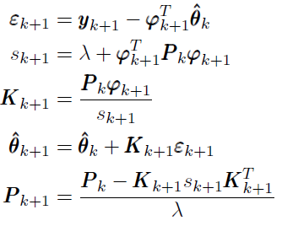
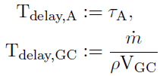
Parameter estimation and residuals
Recursive linear Least Squares (RLS)
Regularization and robustness
The ambient temperature perturbed the system sufficiently
Forgetting factor
Time delays
Problem with information density
Residual whitening: less normal signals

Slide 14
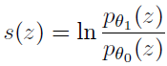
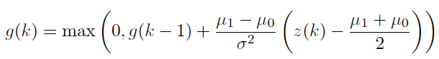
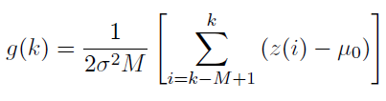
Fault Detection
Signal choices
Residual for detection: heat transfer
Residual for reconstruction: enthalpy
Log likelihood ratio
CUSUM
GLR
Window length: 100 s

Slide 15
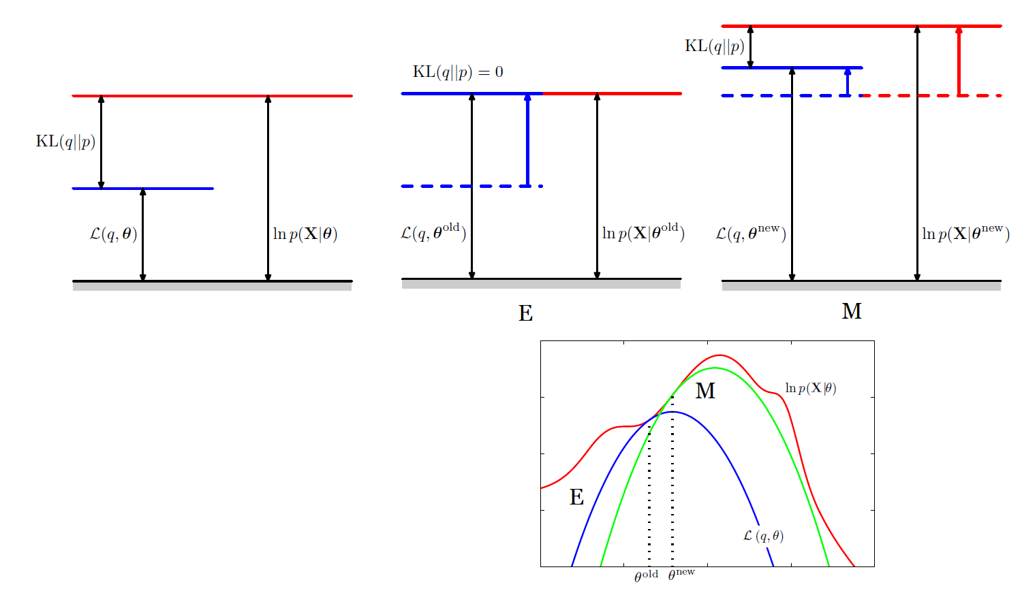
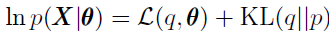
Fault Detection – Expectation Maximization
Latent variable models
E step: changing the structure
M step: changing the parameters

Slide 16
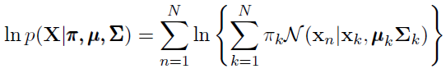
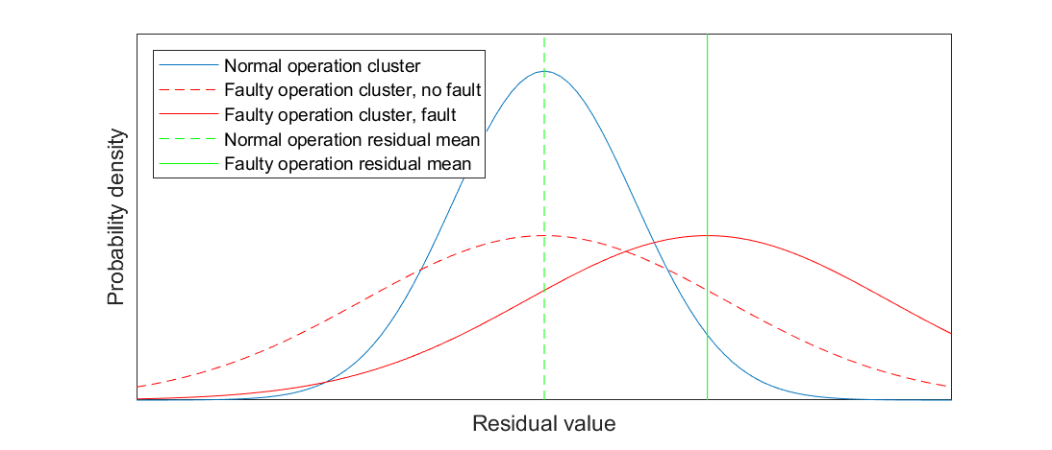
Fault Detection – Expectation Maximization
Gaussian Mixture Model (GMM) with two clusters:
Normal and faulty operation clusters
The following log likelihood is maximized:
Window length: 10 s

Slide 17
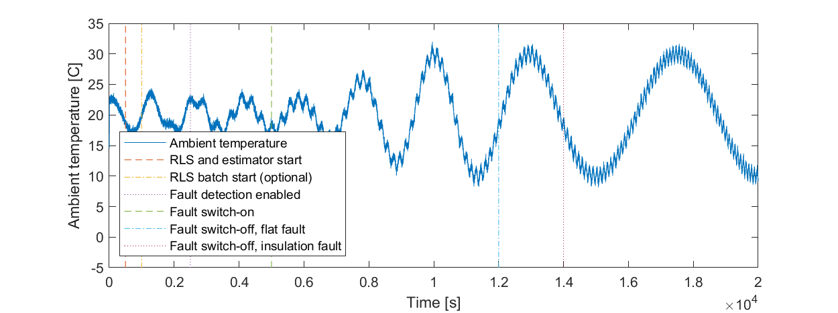
Fault handling
Fault handling does not stop until human intervention
Strong detectibility and measurement reconstruction are achieved by freezing the parameter values after detection

Slide 18
Results and Evaluation
Objectives
Fault detectors
Measurement reconstruction
Application
Control performance
State estimation quality

Slide 19
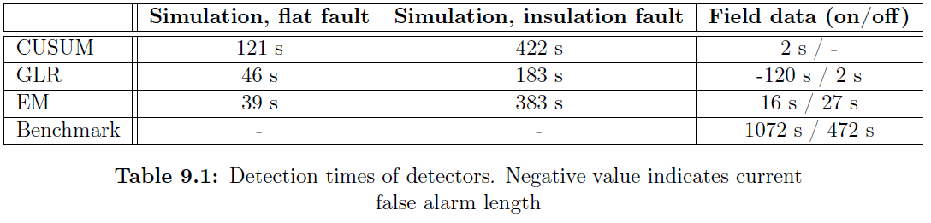
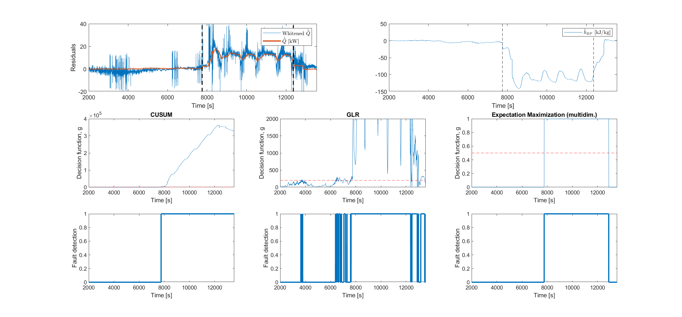
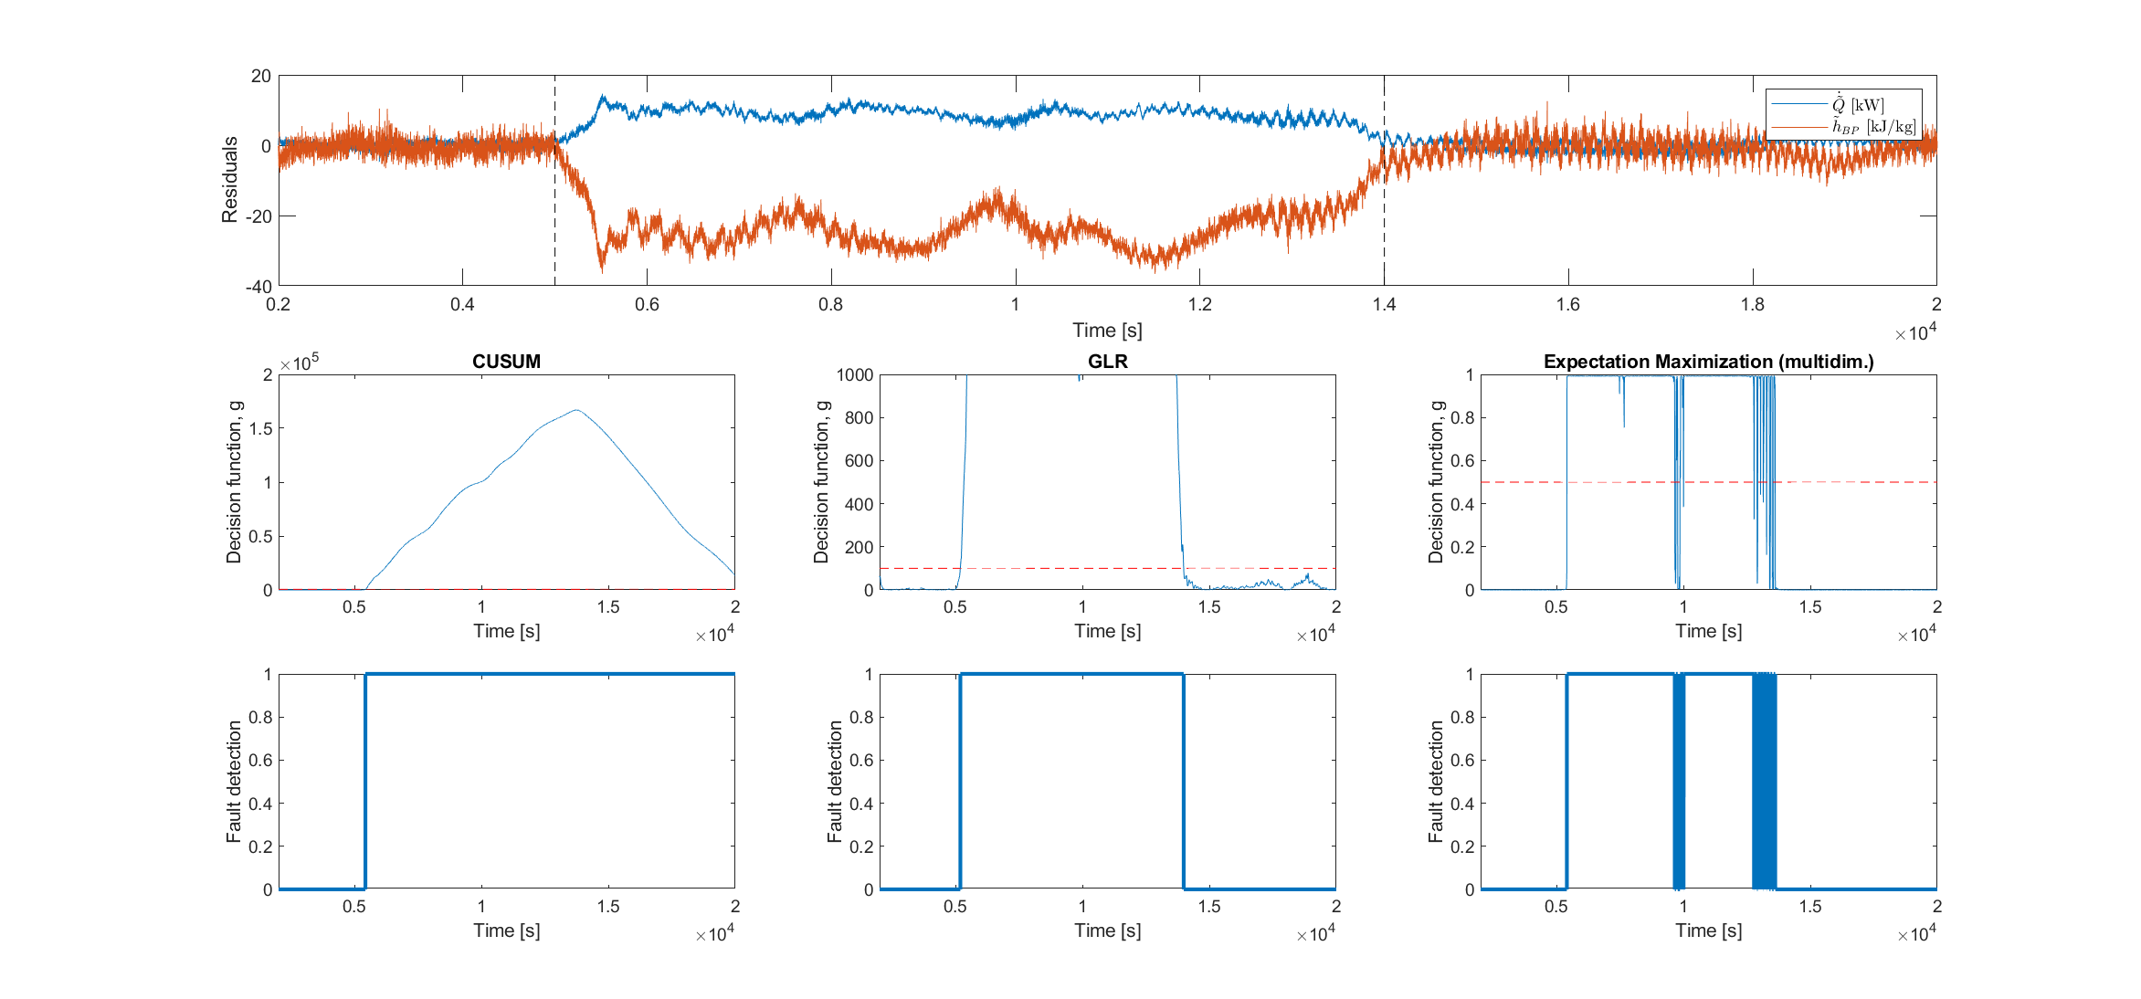
Results and Evaluation - fault diagnosis
Residual signals: strong detectibility
Fault detector
Detection times

Slide 20
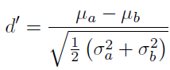
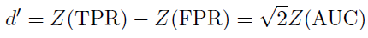
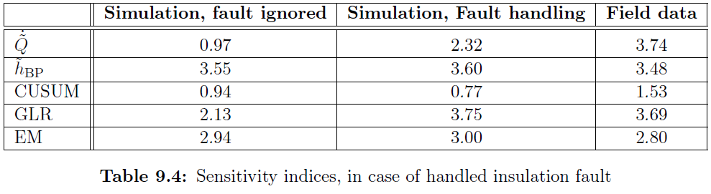
Results and Evaluation - fault diagnosis
Fault detector
Area under the ROC curve, and sensitivity index

Slide 21
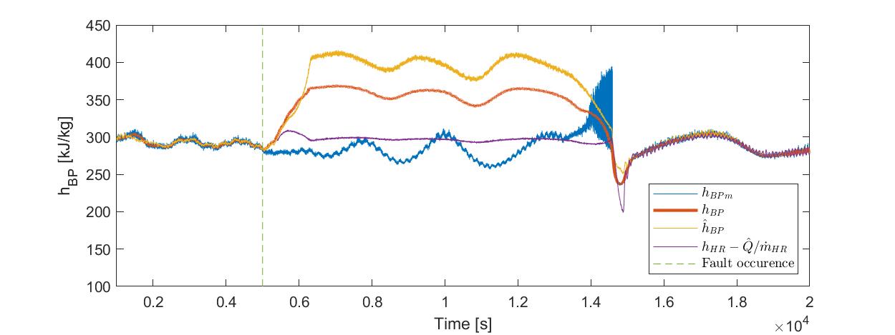
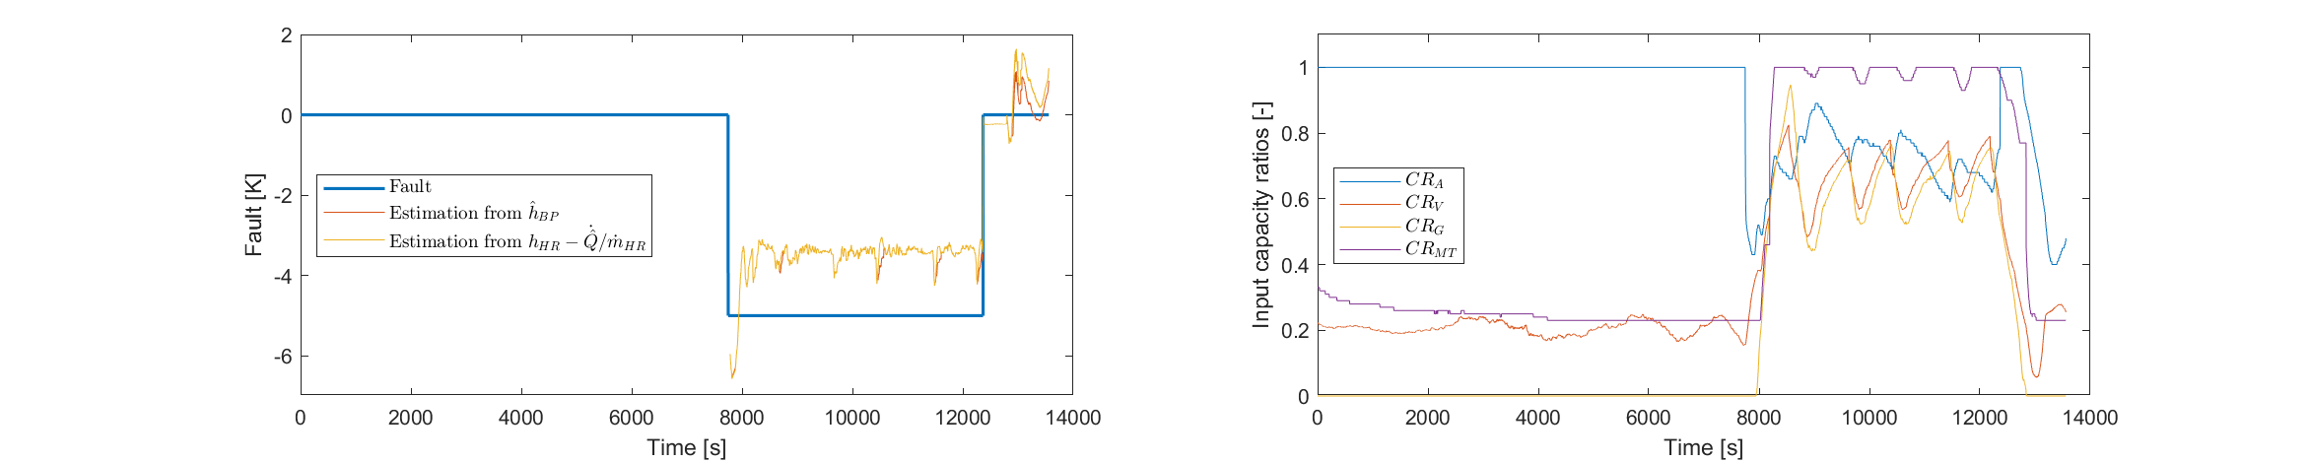
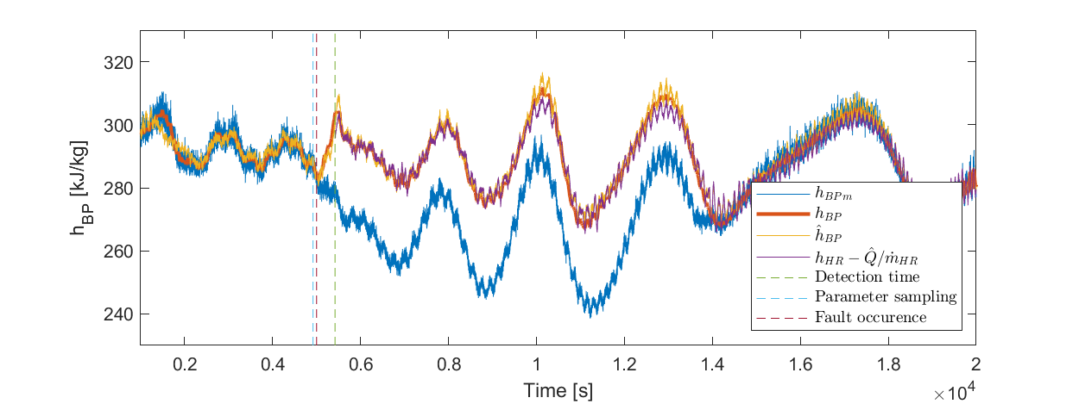
Results – measurement reconstruction
For simulations, insulation fault scenario is considered

Slide 22




Results and Evaluation – control performance
Coefficient of performance
Cabinet temperatures
Inputs are no longer saturated

Slide 23

Results – state estimation quality
Only simulations considered – values can be extracted for analytical approximations
CPU running time depends on set-point sampling rate

Slide 24



Results – state estimation quality

Slide 25
Conclusion
Robust residual signals are generated
Can be used for early detection and measurement reconstruction
Works for field experiment data as well
Application evaluation
Challenges
Fault diagnosis is harder, where the effects are less pronounced
Change of operation-point has the same effect on state estimator residuals, as the faults
Findings
Estimator capturing the most important traits of the system
RLS with physical assumption as residual generator of a nonlinear system
Expectation Maximization online fault tracking algorithm

Slide 26
Future work
Field experiments with fault handling
Extending operation domain to include bypass valve and heat recovery unit as well
Evaluating the EM detector in a more equal environment and testing fault isolation
Using estimator for prediction and enhancing advanced control strategies

Slide 27



Thank you for the attention!

Slide 28
Appendix

Slide 29
Refrigeration systems

Slide 30




Residual whitening
Applying the inverse filter of
Input signal: ambient temperature
Main criteria
Results

Slide 31


Fault Detection – Expectation Maximization
Gaussian Mixture Model (GMM) with two clusters:
Normal and faulty operation clusters
The following log likelihood is maximized:
Window length: 10 s

Slide 32

Results – measurement reconstruction
For simulations, insulation fault scenario is considered

Slide 33


Results – state estimation quality
Only simulations considered – true values can be extracted
Weighted average is considered for virtual enthalpy of gas cooler:
CPU running time depends on set-point sampling rate

Slide 34


Corrections
The line widths in the following figures are not everywhere correct:
The E and M steps are not well noted in this figure:

